Slide 1
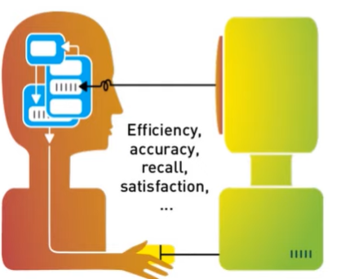
Introduction of Human Computer Interaction

Slide 2
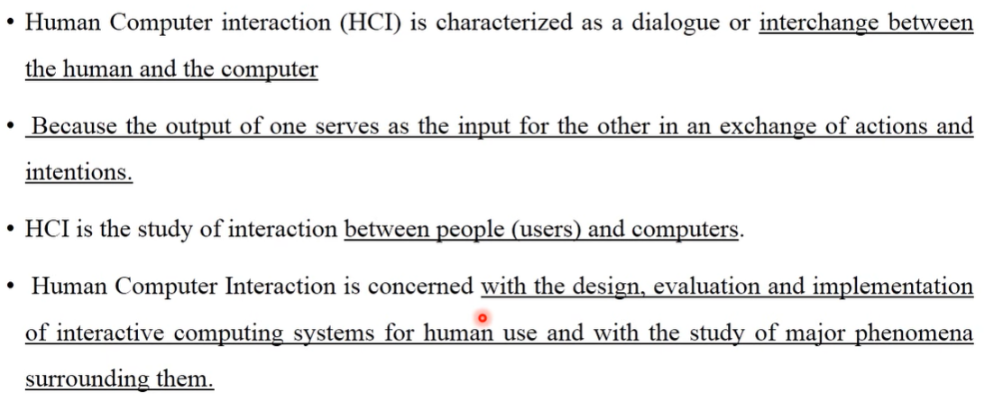
What is HCI?

Slide 3
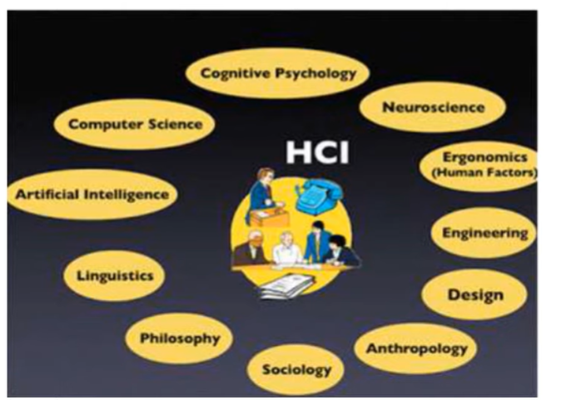
HCI is an Interdisciplinary field

Slide 4
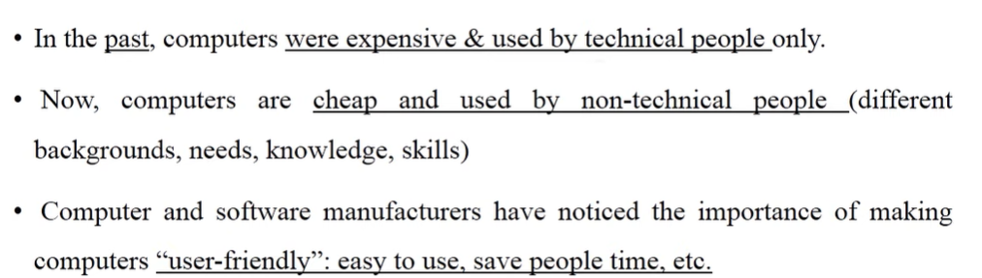
Why HCI

Slide 5
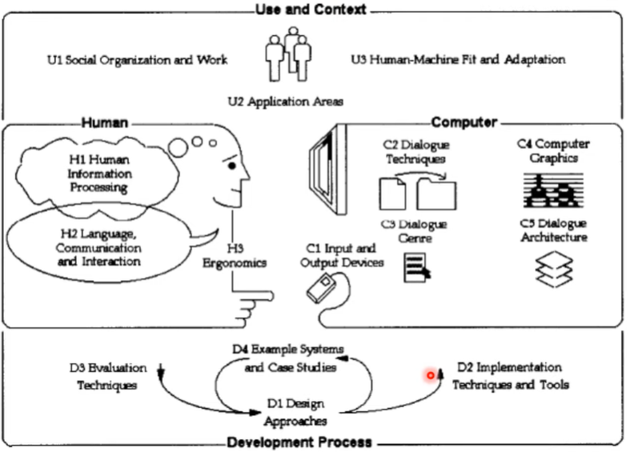
HCI Scope

Slide 6
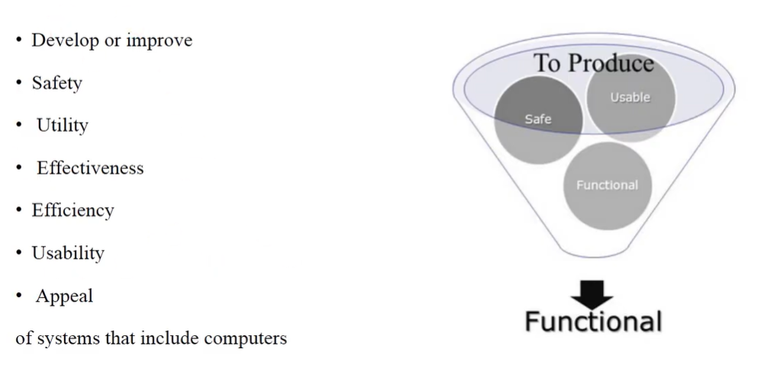
Goal of Human Computer Interaction

Slide 7
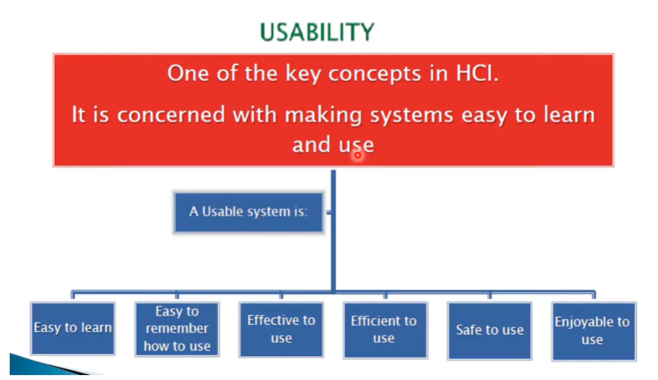
Basic Goal of HCI

Slide 8
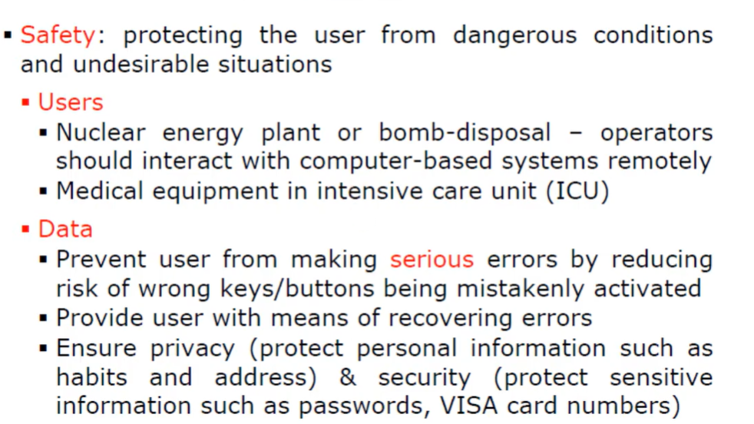
HCI Goals in detail

Slide 9
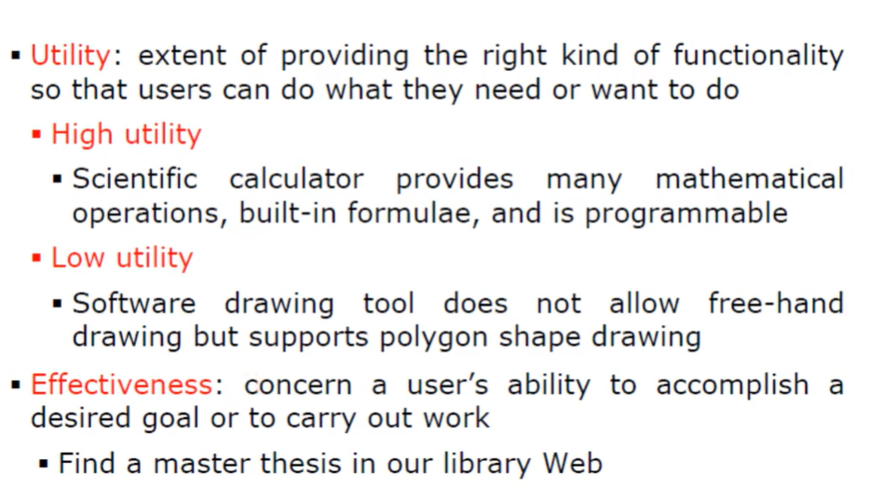
HCI Goals in detail

Slide 10
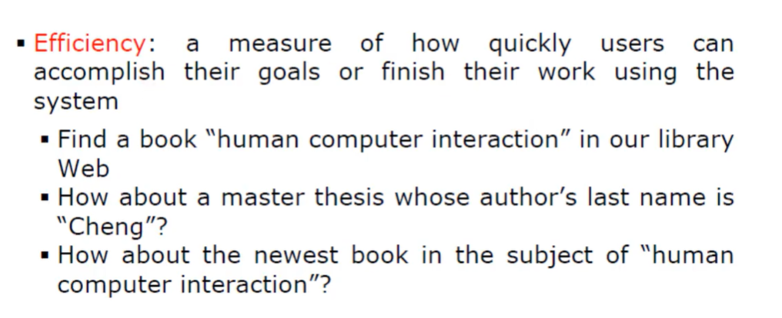
HCI Goals in detail

Slide 11
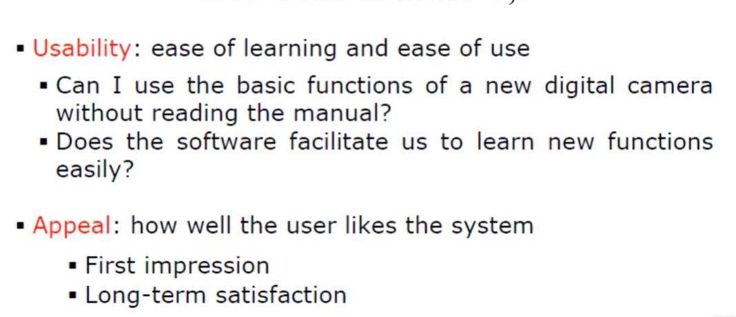
HCI Goals in detail

Slide 12
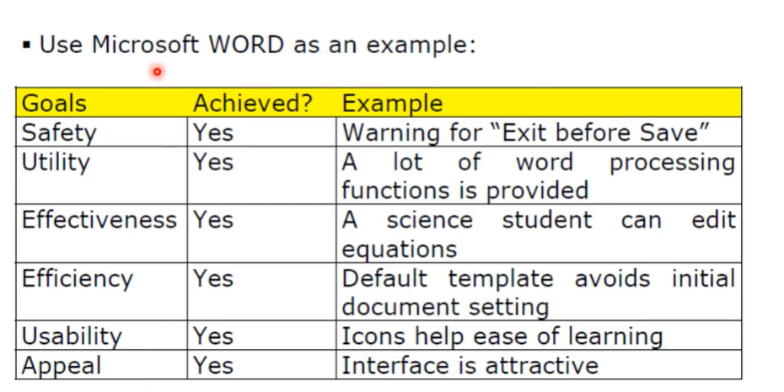
HCI Goal Example

Slide 13
HCI Benefits
Gaining Market Share
Improving Productivity
Lowering Support Cost
Reducing Development Cost etc.

Slide 14
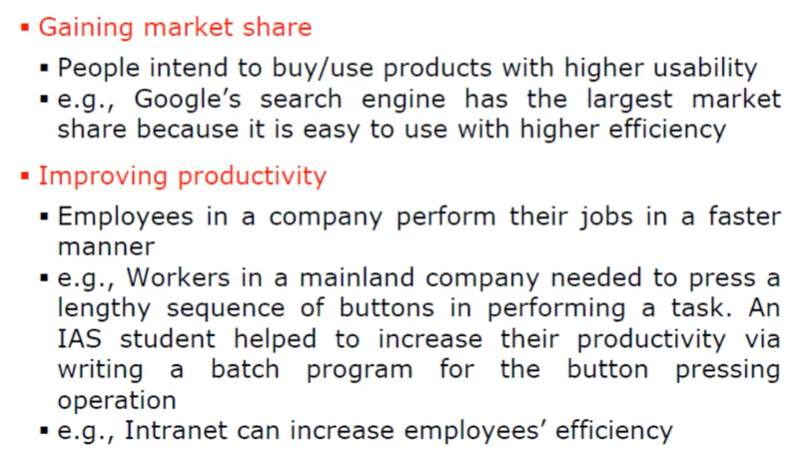
HCI Benefits Description

Slide 15
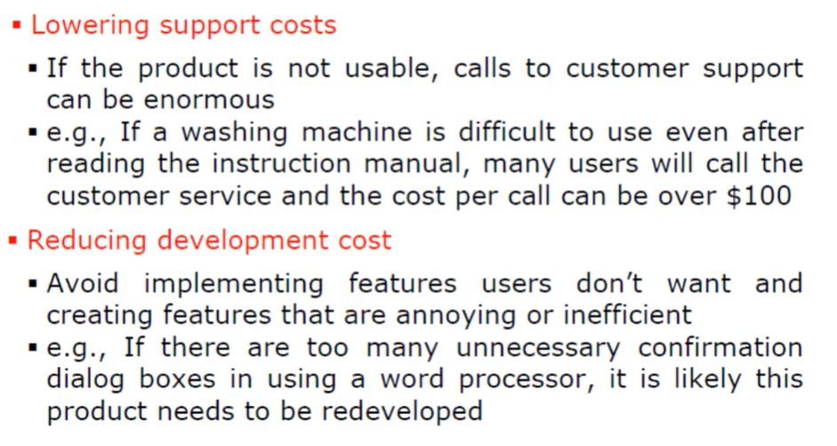
HCI Benefits Description

Slide 16
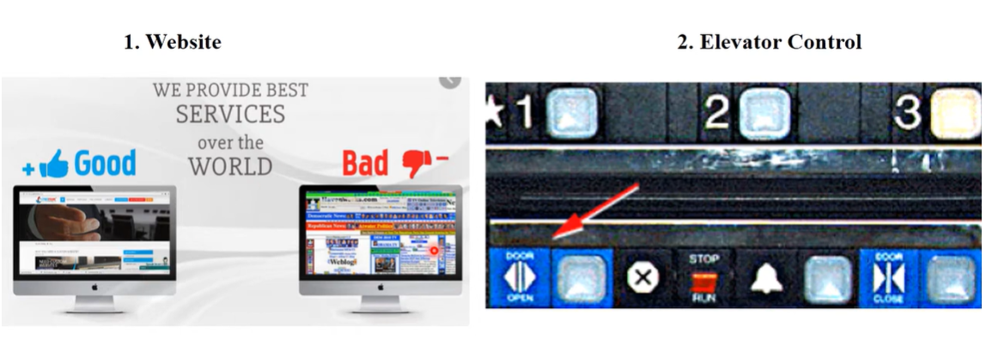
Good or Poor Design Example

Slide 17
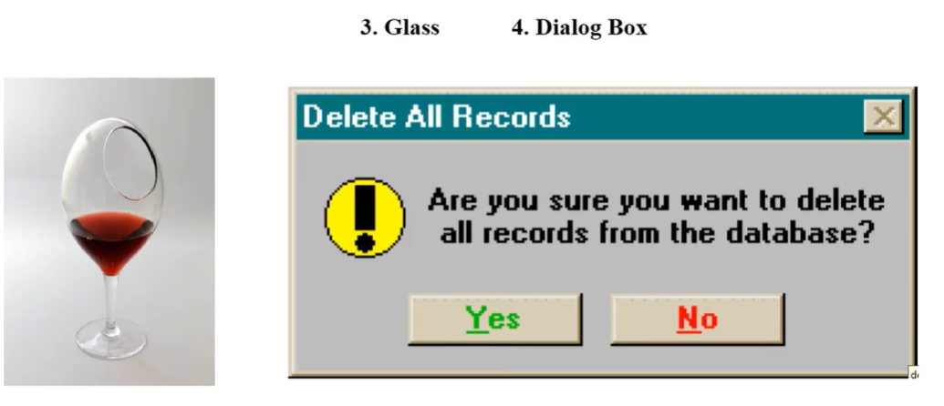
Good or Poor Design Example

Slide 18
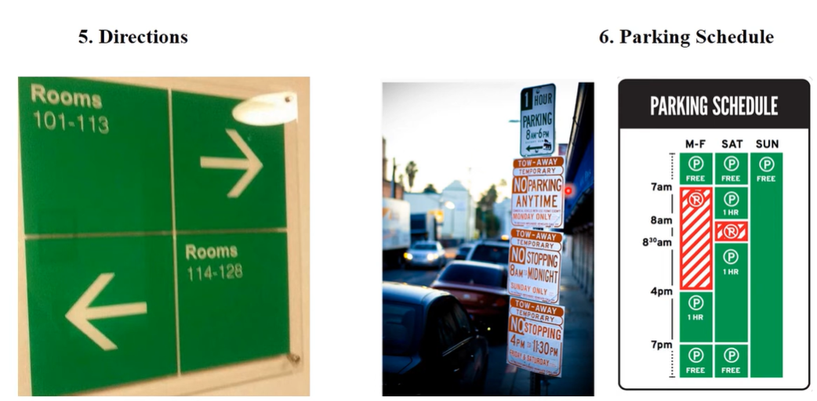
Good or Poor Design Example

Slide 19
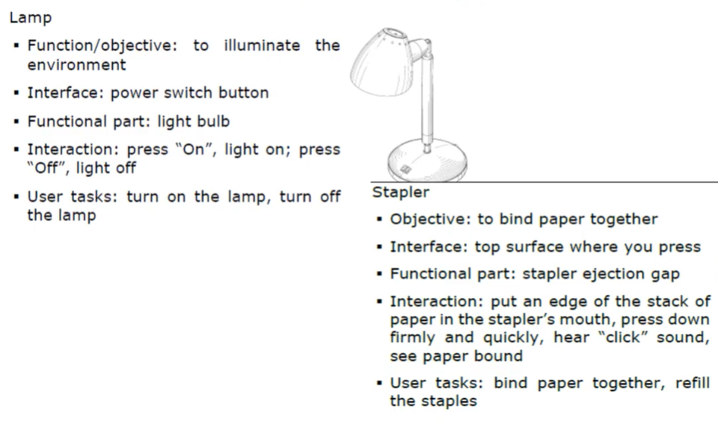
Functionality of HCI

Slide 20
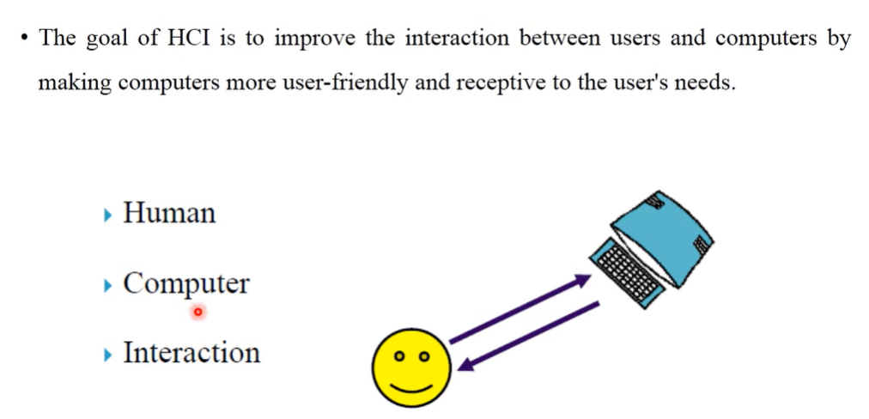
Components of HCI

Slide 21
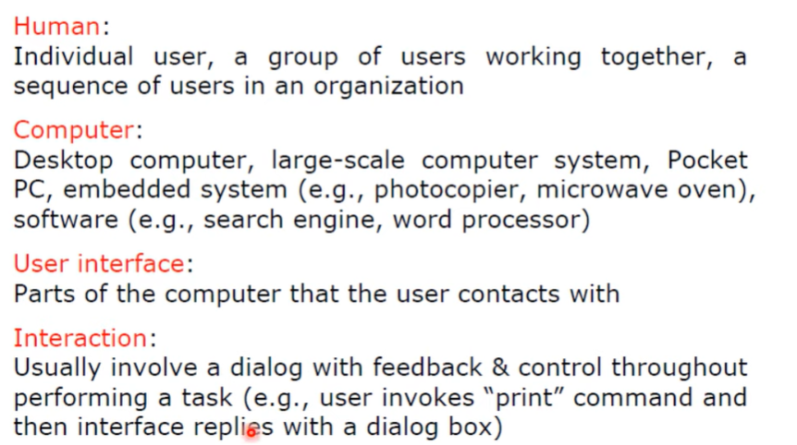
Components of HCI

Slide 22
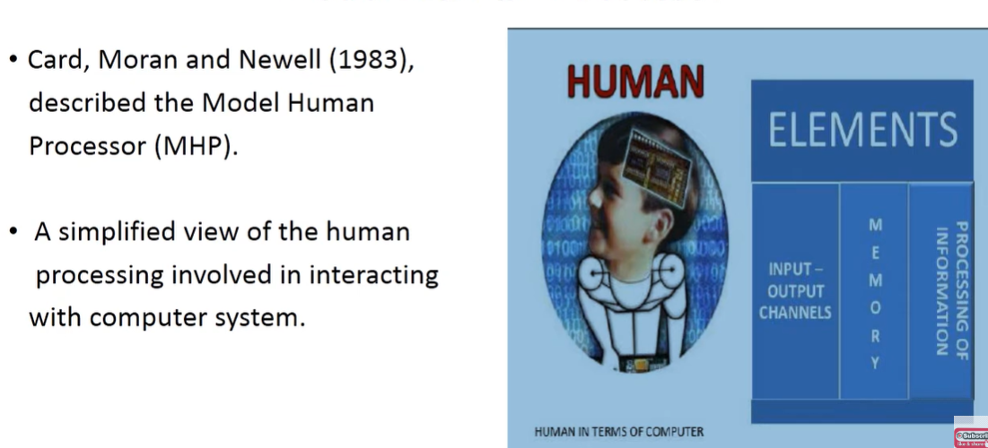
Model of Human Processor

Slide 23
Why do we need to understand Human?
Interacting with technology is cognitive.
Human information processing referred to as cognition.
Human cognition process is involved when interacting with system, like attention, perception and recognition, memory, learning, reasoning, problem solving and decision making.
Need to take into account cognitive processes involved and cognitive limitations of users.
Provides knowledge about what users can and cannot be expected to do.
Identifies and explains the nature and cause of problems users encounter.
Must consider what are users good and bad at?

Slide 24
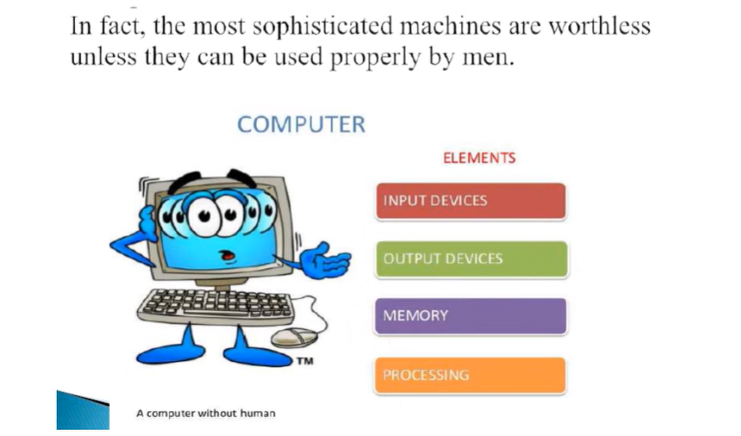
Computer

Slide 25
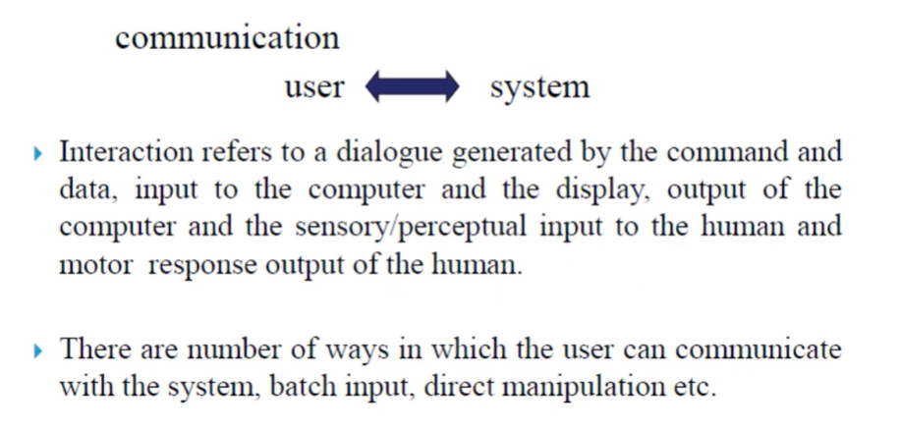
What is interaction?

Slide 26
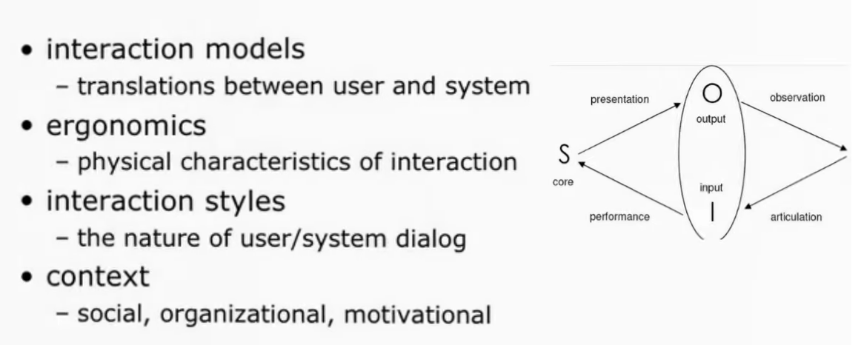
Interaction Includes:
The Interaction

Slide 27
Some terms of Interaction
Domain – The area of work under study. E.g graphic design.
Goal – what you want to achieve. E.g create a solid red triangle
Task – how you go about doing it.
-ultimately in terms of operations or actions.
e.g select fill tool, click over triangle
.

Slide 28
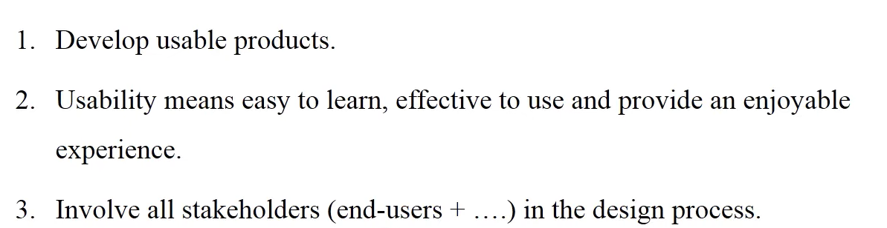
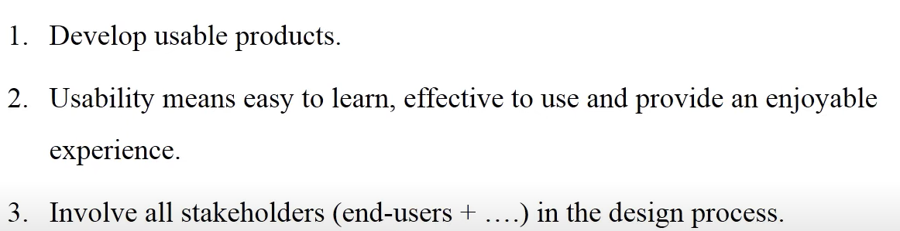
Goals of Interaction

Slide 29
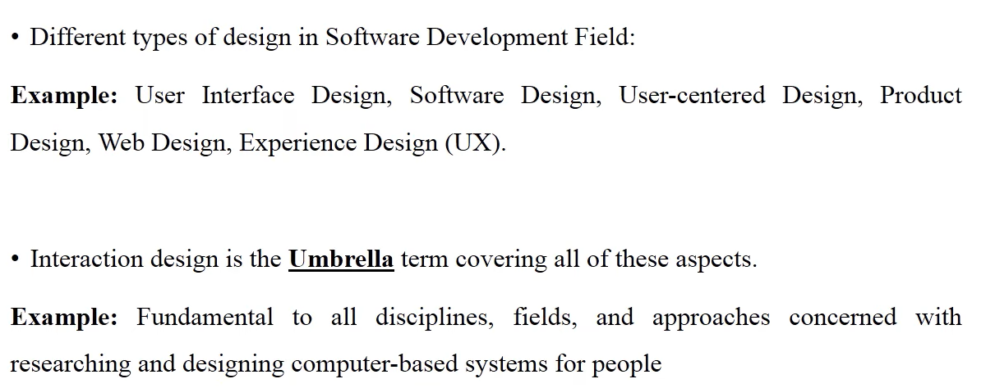
Scope of Interaction

Slide 30
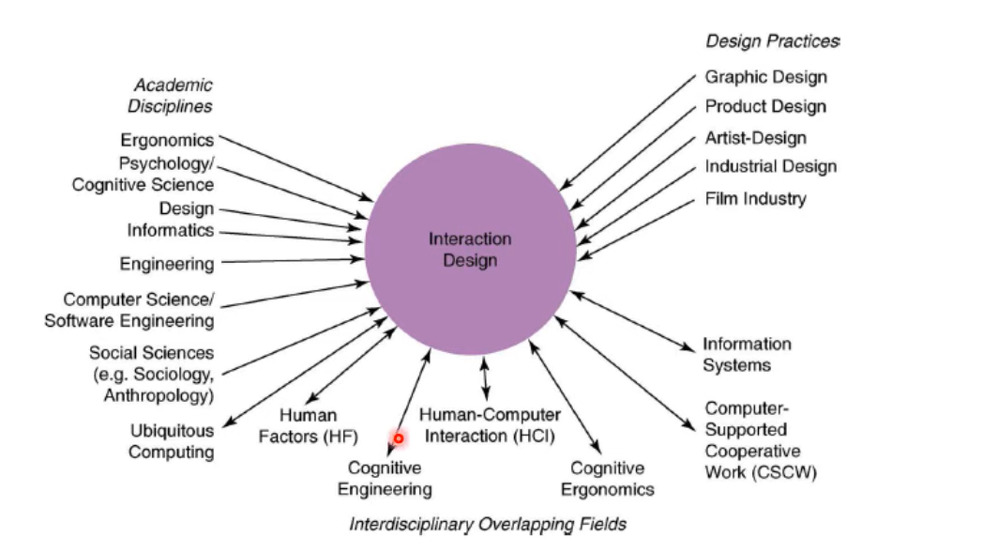
HCL and Interaction Design

Slide 31
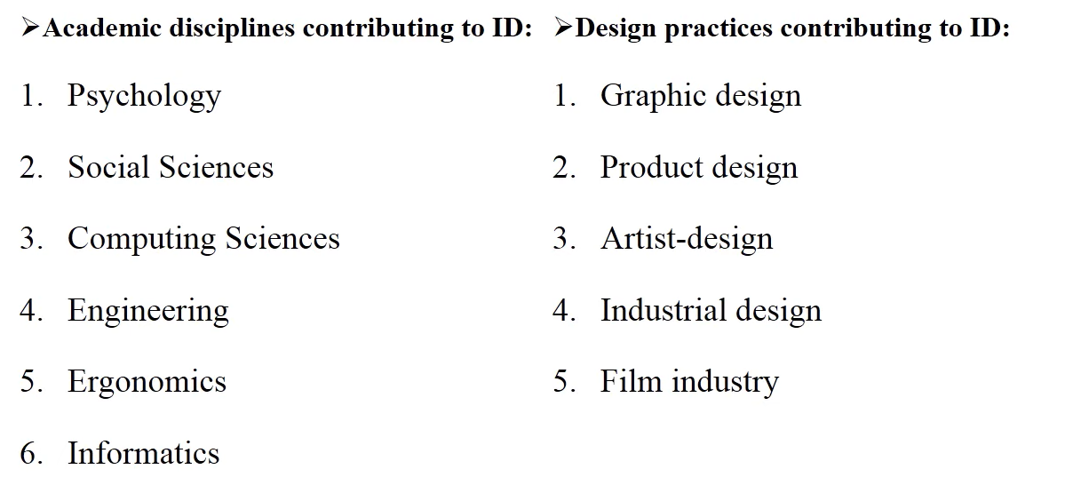
Relationship between ID, HCL and other Field

Slide 32
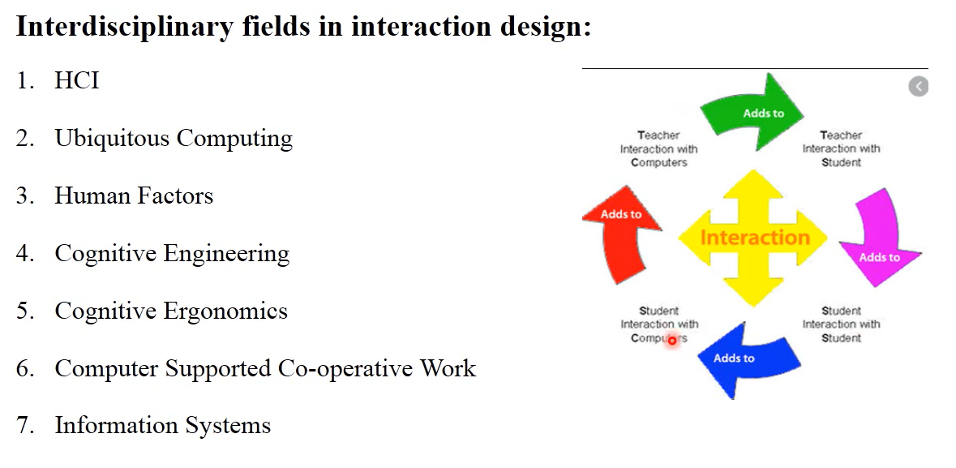
Relationship between ID, HCL and other Field

